Slide 1
Myanmar’s Transitional Justice Period and Continued Strife
By Jonah DiCorcia

Slide 2
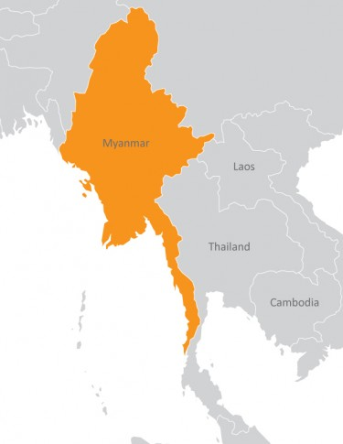
Introduction
Constant war for the past 50 years
Insurgent groups
Recent elections
http://childsdream.org/myanmar/

Slide 3
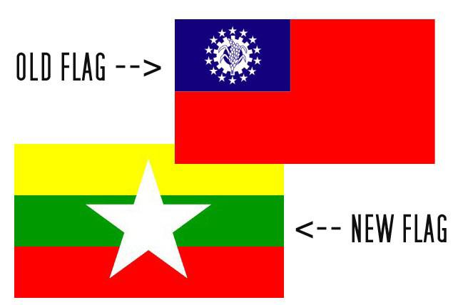
Myanmar's Historical Background
Receiving its name
Becoming a colony
WW2
Brief Democracy
Rise of insurgent groups
Military coup
http://livingcharm.com/wp-content/uploads/2016/07/

Slide 4
The Catalyst for Conflict
Military Dictatorship that targeted other political groups, ethnic minorities, and other groups they deemed dangerous.
Banning threats
Country brought to financial ruin

Slide 5
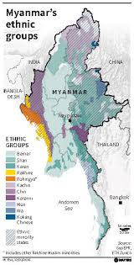
Insurgents Rising
Insurgent groups forming
Displacement
https://www.globalsecurity.org/military/world/war/burma.htm

Slide 6
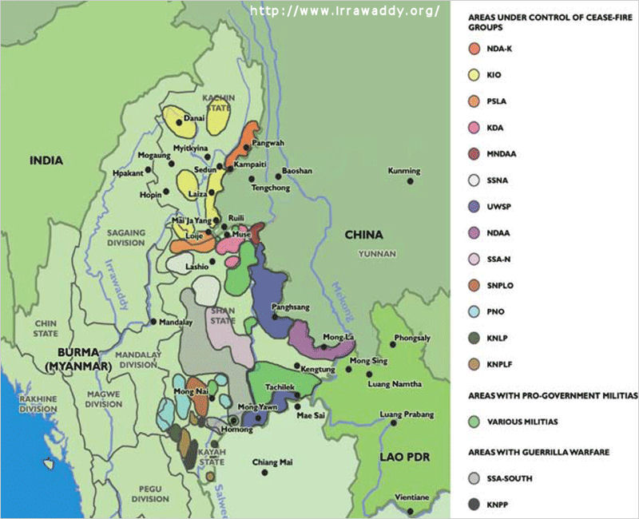
Key Actors
Ne Win and the military
Insurgent groups
KIA
TNLA
MNDAA
AA
External Actors

Slide 7
Cause for War- Material and Political Interests
The political
The material

Slide 8
Atrocities Committed
Unlawful imprisonment and killings
Rape
Child soldiers
Ethnic cleansing

Slide 9
Beginnings of Peace
First elections
New government
Cease fire

Slide 10
Transitional Justice Mechanisms Used after the war
Releasing and reviewing of prisoners
Immunity to former rebels and government officials

Slide 11
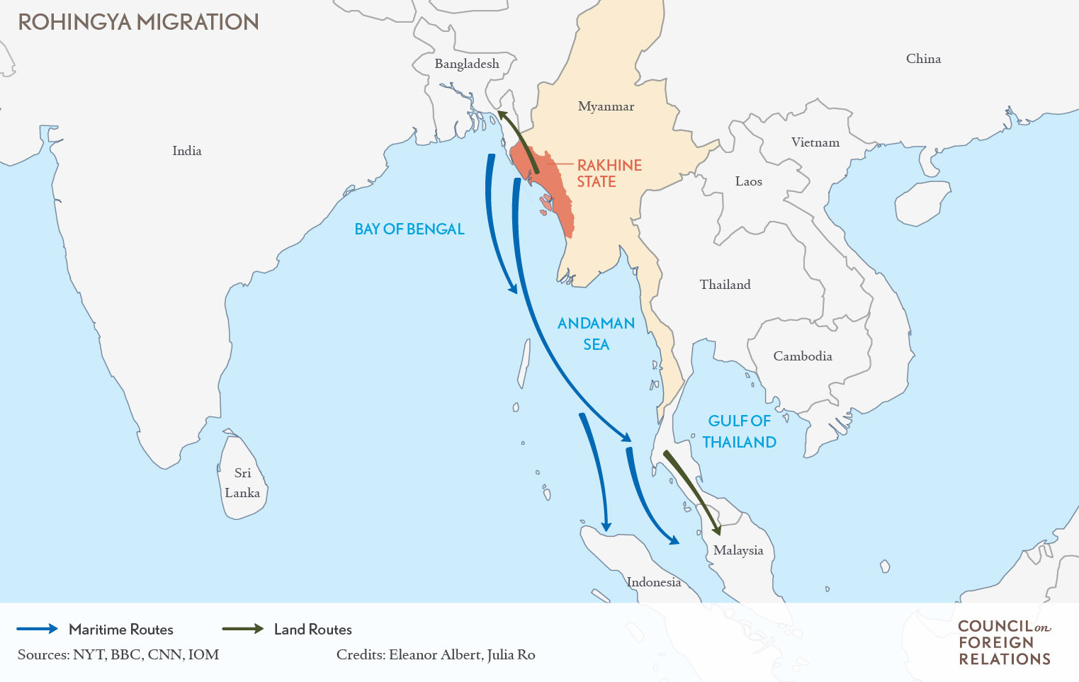
Myanmar Today
Economy
Insurgent groups
Military power
Political prisoners
Recent genocide
needull.com

Slide 12
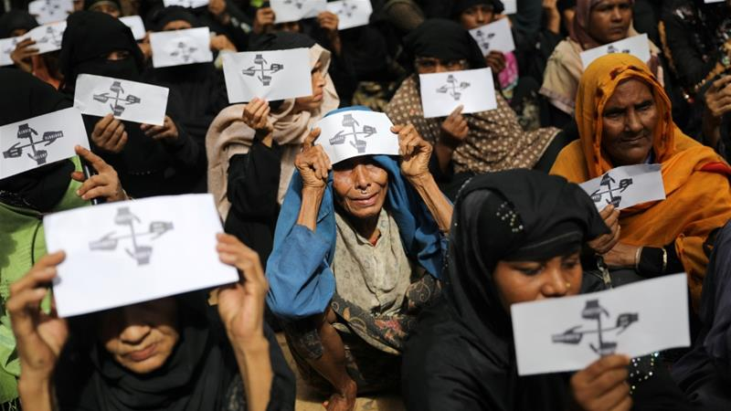
Conclusion
Small steps forward…
A large step back.
Myanmar needs
Truth commission
Justice
https://www.aljazeera.com/news/2018/09/canada-declares-myanmar-rohingya-killings-genocide-180921062428272.html

Slide 13
did you agree with my conclusion that Myanmar is taking steps back in its transitional process?

Slide 14
What are your thoughts towards complete immunity for crimes of previous regimes?

Slide 15
Many of the countries were once colonies. Many previously colonies are still in turmoil. Do you believe that any of these former empires owe their once colonies reparations?

Slide 16
Sources
International Center for Transitional (2014) Navigating Paths to Justice in Myanmar’s Transition Justice. Retrieved October 15, 2018, from PDF online: https://www.ictj.org/sites/default/files/ICTJ-Myanmar-Development-Report-2014.pdf
International Center for Transitional Justice. "Myanmar & Transitional Justice." ICTJ Justice Truth Dignity. Last modified 2018. https://www.ictj.org/ our-work/regions-and-countries/burmamyanmar.
International Center for Transitional Justice Prospects for Justice in Myanmar. November 2016. https://www.ictj.org/sites/default/files/ICTJ-Briefing-Myanmar-TJ-2016.pdf.
Thomson, Aileen. International Center for Transitional Justice, Opening Up Remedies in Myanmar. December 2015. https://www.ictj.org/sites/default/ files/ICTJ-Briefing-Myanmar-TJ-2015.pdf.
Human Rights Watch. "Burma: Growing Political Prisoner Population." Human Rights Watch, January 17, 2016. https://www.hrw.org/news/2016/01/17/ Burma-growing-political-prisoner-population.’
Godrej, Dinyar. "A Short History of Burma." New Internationalist, April 18,
2008. https://newint.org/features/2008/04/18/history.
Pierce, Patrick. "ICTJ Briefing." Impunity or Reconciliation in Burma‘s
Transition, December 2010. https://www.ictj.org/sites/default/files/
ICTJ-Myanmar-Transition-2010-English.pdf.

Slide 17
cont..
Watson, Ivan. "Myanmar's hidden war." CNN, November 11, 2015.
https://www.cnn.com/2015/11/11/asia/myanmar-shan-rebels-civil-war/index.html.
Pike, John. "Burma Insurgency." Global Security. Last modified 2018.
https://www.globalsecurity.org/military/world/war/burma.htm.
De Coning, Cedric, and Charles Call, eds. Rethinking Peace and Conflict Studies.
Cham, Switzerland: Dove illustration, Dove illustration.
https://link.springer.com/content/pdf/10.1007%2F978-3-319-60621-7.pdf.
Shaw, Steve. "Burma‘s Quiet Genocide." New Internationalist, February 20,
2017. https://newint.org/features/web-exclusive/2017/02/20/
burmas-quiet-genocide.
Barron, Laignee. "More Than 43,000 Rohingya Parents May Be Missing. Experts Fear
They Are Dead." Times, April 24, 2018. http://time.com/5187292/
rohingya-crisis-missing-parents-refugees-bangladesh/.

